Slide 1

Java
Object Oriented Programming Structure

Slide 2

Content
01. Object Oriented Programming
02. OOPS Vs Procedural
03. OOPS Concepts
04. Encapsulation
05. Abstraction
06. Inheritance
07. Polymorphism

Slide 3
Object Oriented Programming

Slide 4
Object Oriented Programming (OOPs)
Object-Oriented Programming is a methodology or paradigm to design a program using Classes and Objects

Slide 5




Object Oriented Programming (OOPs)
Real world entities that has their own properties and behaviours
Class Dog
Blueprint from which an objects properties and behaviours are decided
Properties
Behaviour
breed
eat()
size
sleep()
age
run()
color
bark()

Slide 6
Object Oriented Programming(OOPs)
For different values of data members (breed size, age, and color) in Java class, you will get a different dog object

Slide 7
Object Oriented Programming (OOPs)
Properties
Properties
Properties
Properties
breed
breed
breed
breed
size
size
size
size
age
age
age
age
color
color
color
color
Behaviour
Behaviour
Behaviour
Behaviour
eat()
eat()
eat()
eat()
sleep()
sleep()
sleep()
sleep()
run()
run()
run()
run()
bark()
bark()
bark()
bark()

Slide 8
Java Objects
A real-world entity that has state and behaviour is known as an object
02
Behavior
It is the functionality) of an object
01
State
It is the data (value) of an object
03
Identity
The object identity is typically implemented via a unique ID that is used internally by the JVM
CHARACTERISTICS

Slide 9
Java Classes
A class is a blueprint of object having properties
class <class_name>{
field;
method;
}

Slide 10
Java Classes (Contd.)
Fields
A class may contain
Methods
class <class_name>{
field;
method;
}
Constructors
Blocks
Nested Class & Interface

Slide 11
OOPS vs Procedural Programming

Slide 12
Object Oriented Programming
Procedural Programming
Bottom Up approach
Top Down Approach
Divided into objects
Divided into functions
Has Access Modifiers
Doesn’t have Access Modifiers
Objects can move & communicate with each other through member functions
Data can move freely from function to function in the system
More secure
Less Secure
Supports overloading
Do not support overloading

Slide 13
Java Methods

Slide 14
Java Methods
A method is a set of code that is grouped together to perform a specific operation
A method must be written inside a class
Each method has its own signature
Java provides two types of methods
Pre Defined or Standard Library Methods
User Defined Methods

Slide 15
Java User Defined Methods
To use a method, you need to perform two steps:
Method Initialization
Method Invocation

Slide 16
Java Methods
Method Initialization
modifier returnType nameOfMethod (Parameter List) {
// method body
}
A method can be parameterized or non-parameterized
Method definition consists of a method header and a method body
You can Overload Method i.e. Provide same name to more than one method but their data type or parameter list must be different

Slide 17
Java Methods
Method Invocation
methodName()
methodName(parameter1, parameter2...)
To use a method it needs to be invoked or called
When a program invokes a method, the program control gets transferred to the called method
A method can be called in two ways:
Call by Value
Call by Reference

Slide 18
Static Vs Non-Static

Slide 19
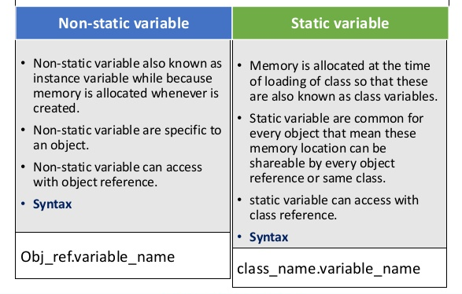
Static vs Non Static

Slide 20
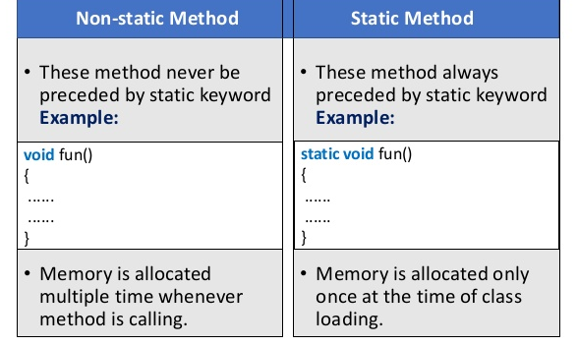
Static vs Non Static

Slide 21
Constructors

Slide 22
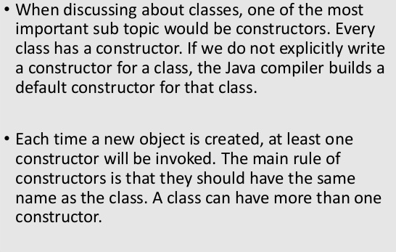
Constructors

Slide 23
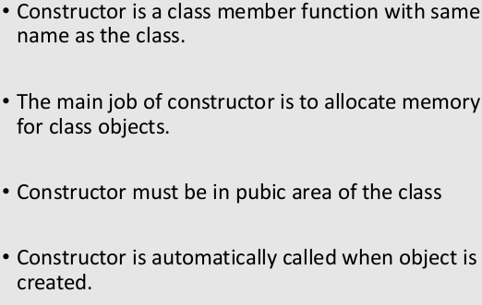
Constructors (Contd.)

Slide 24
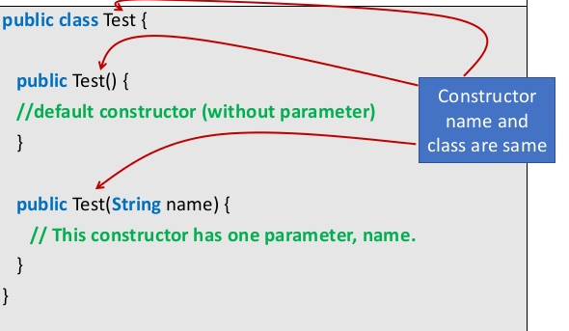
Constructors (Contd.)

Slide 25
OOPs Concepts

Slide 26
OOPs Concepts
Inheritance
Polymorphism
Abstraction
Encapsulation

Slide 27

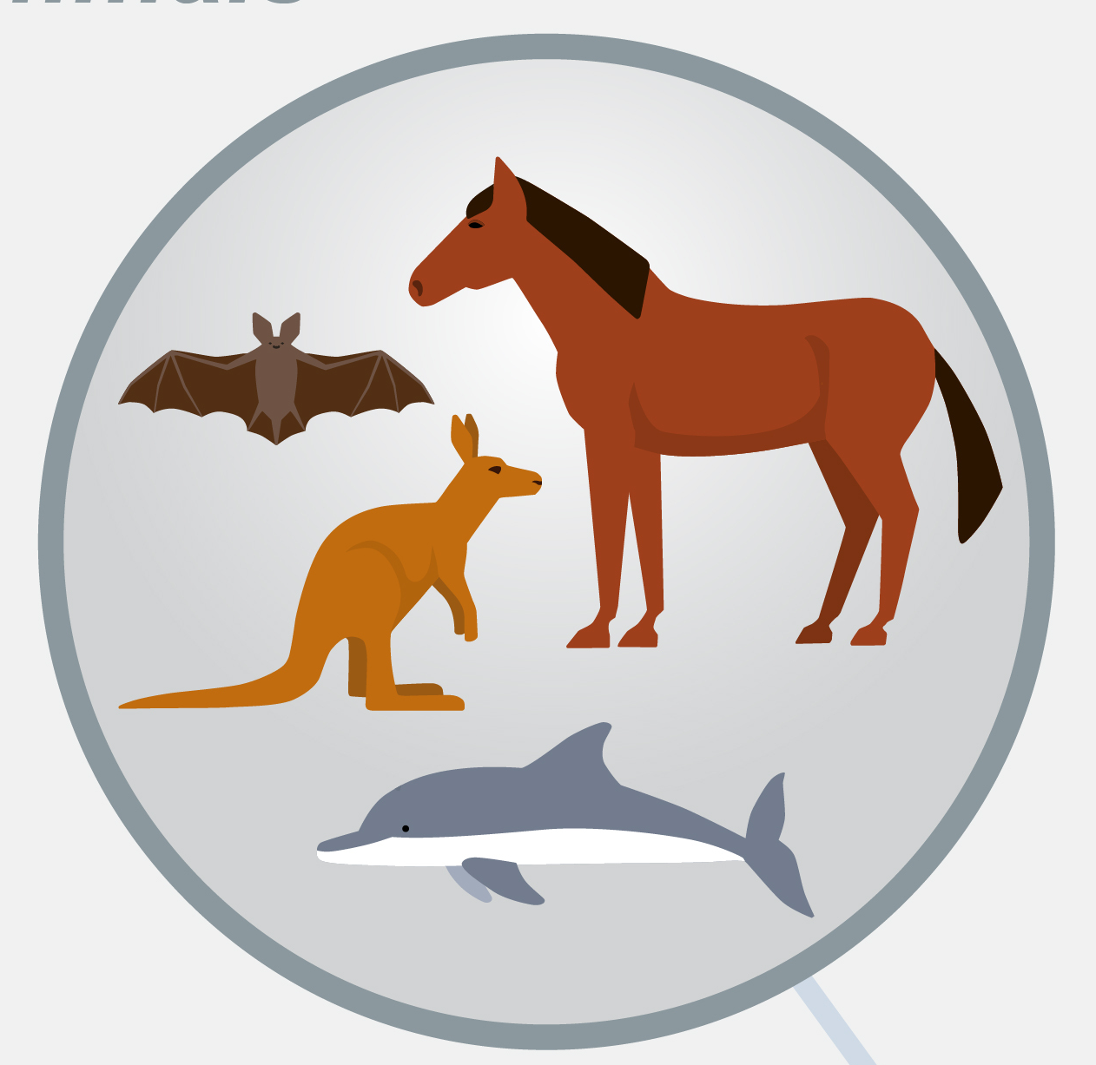
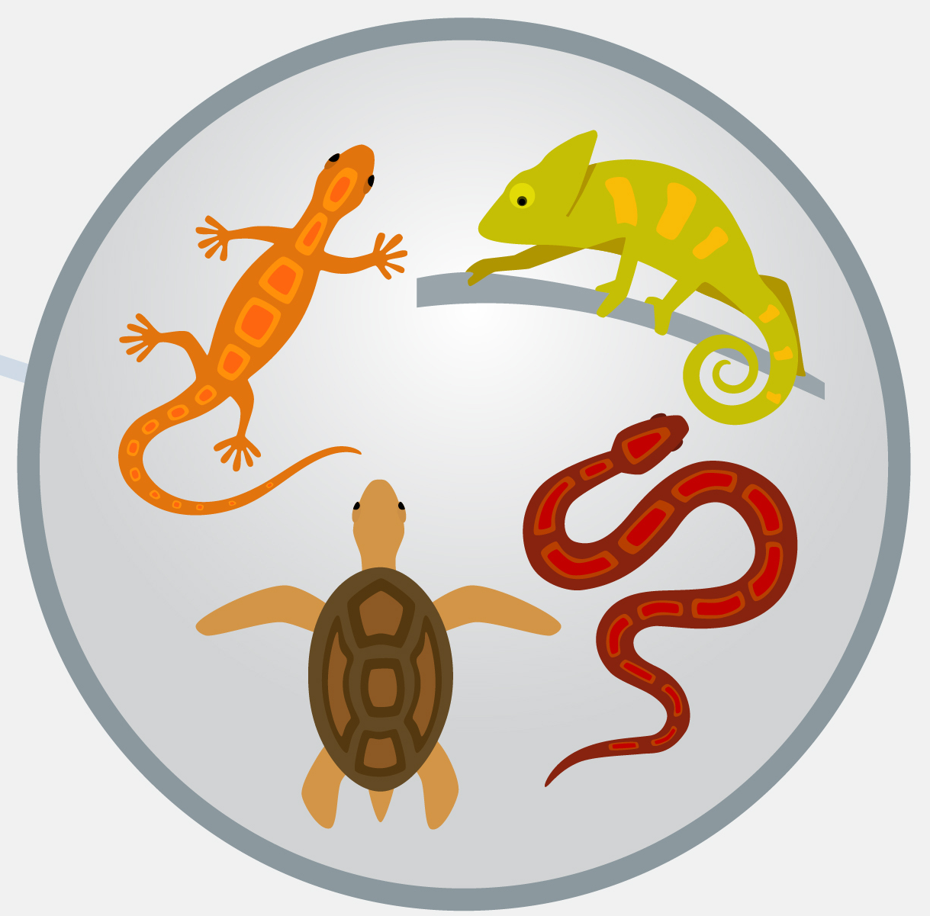
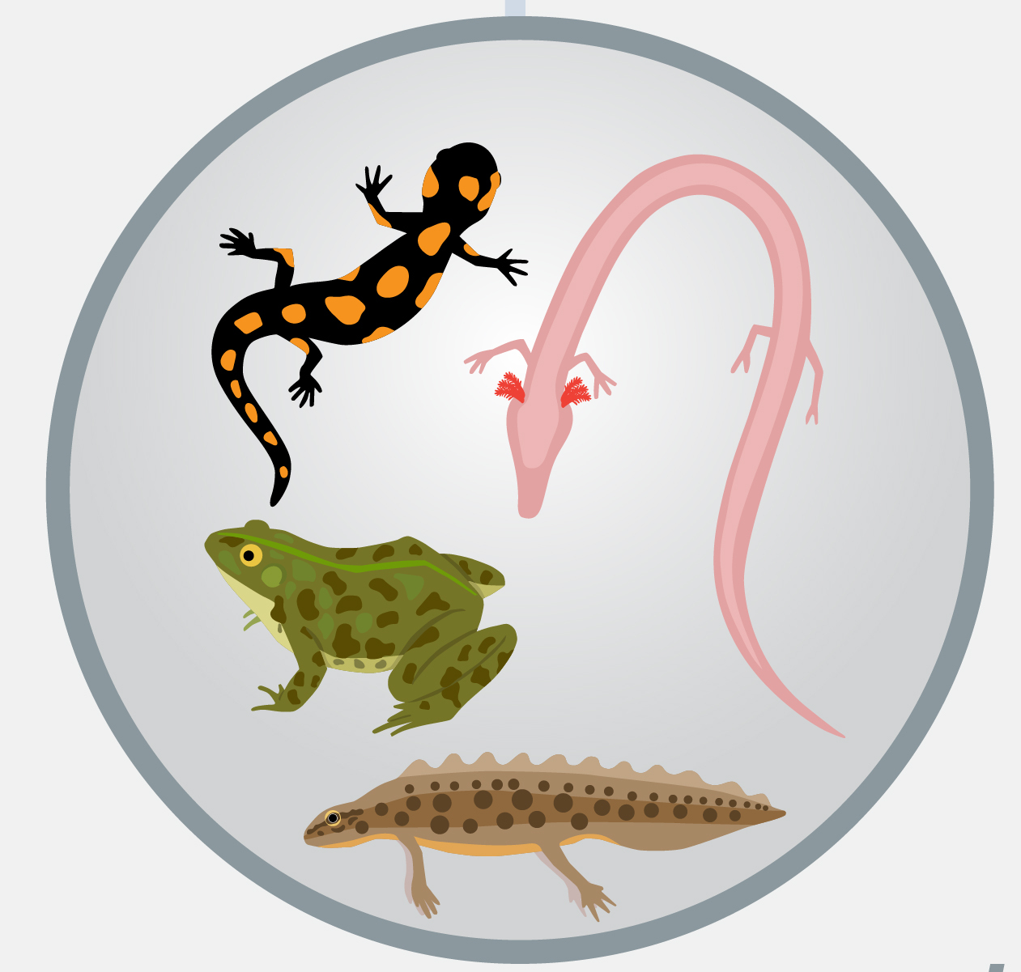

Inheritance
Inheritance is the property of an object to acquire all the properties and behavior of its parent object
Inheritance represents the IS-A relationship which is also known as a parent-child relationship
Super/ Parent Class
Animal
Sub/ Child Classes
Mammals
Reptiles
Amphibians
Birds

Slide 28
Inheritance
Syntax
class Subclass extends Superclass
{
//methods and fields
}
Advantages
Code Reusability
Extensibility
Overriding
Data Hiding

Slide 29
Inheritance
Types Of Inheritance in Java
Single
hierarchical
multilevel

Slide 30
Inheritance - Single
Single level inheritance enables a derived class to inherit properties and behaviour from a single parent class
Class A
Class B

Slide 31
Inheritance - Multilevel
Multi level inheritance enables a derived class to inherit properties and behaviour from a parent class which is also derived from another class
Class A
Class B
Class C

Slide 32
Inheritance - Hierarchical
Hierarchical level inheritance enables more than one derived class to inherit properties and behaviour from a parent class
Class A
Class B
Class C
Class D

Slide 33
Polymorphism
Polymorphism is the property of an object which allows it to take multiple forms
Types Of Polymorphism in Java
Compile time
Run time

Slide 34
Polymorphism – Compile Time
Compile Time Polymorphism or Static Polymorphism is resolved during compiler time
Overloading is an example of compile time polymorphism
Rules For Overloading
1. Overloaded methods must have different argument list
2. It can have different return types if argument list is different
3. It can throw different exceptions
4. It can have different access modifiers

Slide 35
Polymorphism – Run Time
Run Time Polymorphism or Dynamic Polymorphism is resolved during run time
Method Overriding is an example of run time polymorphism
An overridden method is called through the reference variable of a superclass
Rules For Overloading
1. Overriding method argument list must match the overridden method
2. The return type must be the same or subtype of overridden method
3. Access level cannot be more restrictive than overridden method

Slide 36
Abstraction
Abstraction is the methodology of hiding the implementation details from the user and only providing the functionality to them
Ways to achieve Abstraction
Abstract Class
Interface

Slide 37
Abstraction – Abstract Class
An abstract class is a template definition to methods and variables of a class that contains one or more abstracted methods
It can provide from 0 to 100% of abstraction
Must be declared with an abstract keyword
Can have abstract and non-abstract methods
Cannot be instantiated
Can have constructors and static methods
Can have final methods

Slide 38
Abstraction - Interface
An interface in java is a blueprint of a class which contains static constants and abstract methods
It Enables Multiple Inheritance and helps in achieving loose coupling
It provides 100% of abstraction
Class
Interface
Interface
extends
implements
extends
Class
Class
Interface

Slide 39
Why are “Interfaces” used?
Interfaces are used to implement the expected behavior of a system/data types.
Java does not support multiple inheritance, hence interfaces are implemented.

Slide 40
Class
Class
Class
n
interface
interface

Slide 41
Interface
An interface has a set of method declarations.
It does not have the method body but only method declaration.
To use an interface in a class, “implements” keyword is used.
In case you don’t override all the methods in the class the class has to be defined as abstract.
An interface is same as class except class can be instantiated but interface cannot be.
An interface can be defined by using interface keyword and the name of the interface.

Slide 42
INTERFACE
Implements
Class
abstractMethod1()
{
_______
______ }
Abstract Method1();
Abstract Method2();
abstractMethod2()
{
_______
______ }
Abstract Method3();
abstractMethod3()
{
_______
______ }

Slide 43
Where do we use interfaces ?
Any system which needs the expected functionality, requires interfaces.
For example , 2 basic functions of a bank is deposit and withdraw .
These two functions can be part of interfaces for banking applications.

Slide 44
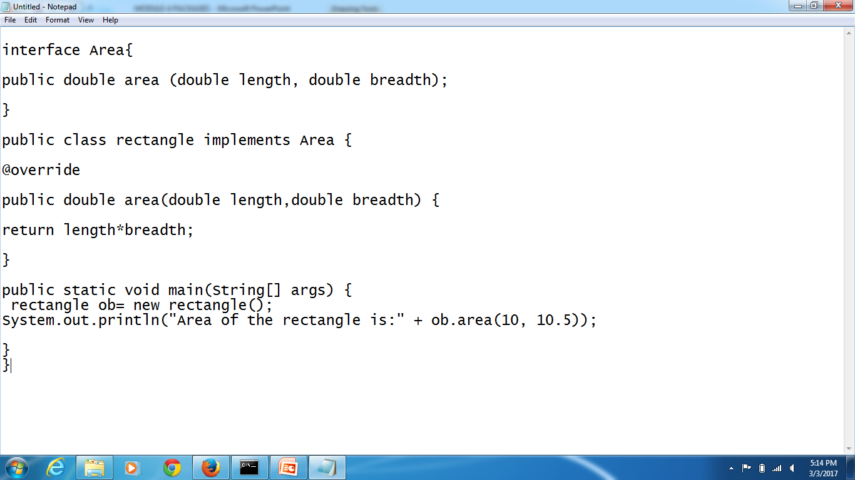
A Program on Interface

Slide 45
Interfaces (Contd.)
Attributes can be defined in interfaces.
These attributes can be used in the implemented class.
The attribute values can’t be changed in the class as it acts like final variables.

Slide 46
class extending an Abstract class which implements an interface.
Class
implements
interface
Class implementing an interface
interface
implements
Abstract Class
extends
Subclass

Slide 47
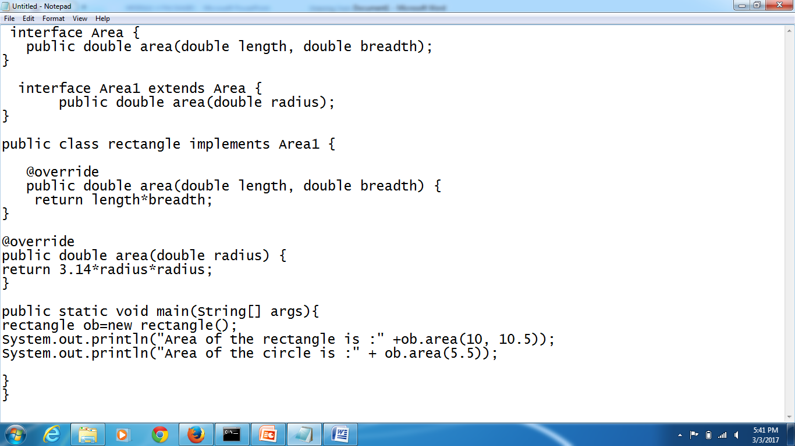
Interfaces can be Extended

Slide 48
Interfaces can be Extended (Contd.)
Like the classes can be extended, even interfaces can be extended .
In the above program, there are two interfaces, interface 1 and interface 2.
Interfaces 2 is extended from interface1. If a class is implementing interface2 then all the methods of interface2 and 1 should be implemented , as interface2 is extended from interface1.

Slide 49
Encapsulation
Encapsulation is the mechanism of wrapping up of data and code acting on the methods together as a single unit
It is achieved by declaring the variables of a class as private and then providing the public setter and getter methods to modify and view the variables values
public getter()
private variables
public setter()

Slide 50
Anonymous Objects

Slide 51
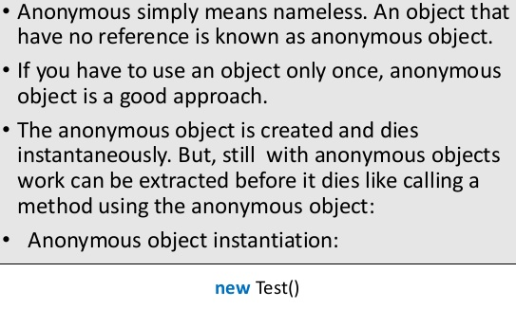
Anonymous Objects

Slide 52
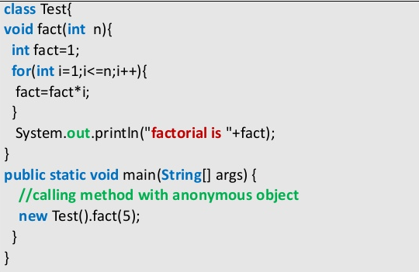
Anonymous Objects

Slide 53
Final Keyword

Slide 54
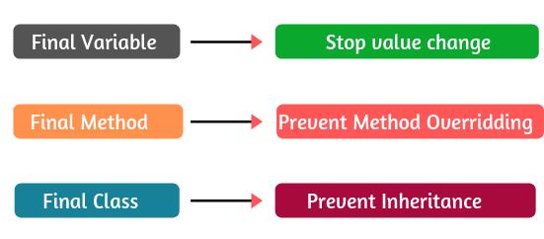
Final Keyword

Slide 55
Object Class and toString Method

Slide 56
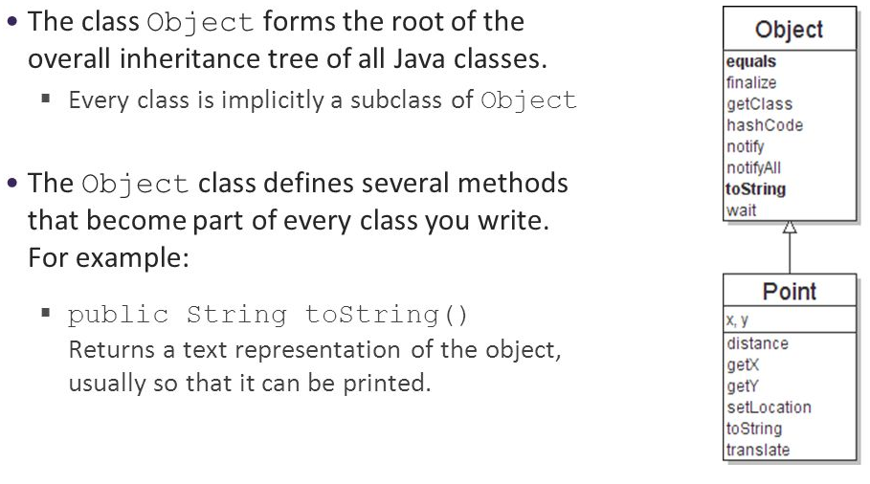

Slide 57
Case Study
Zomato - Elements of Object Oriented Design

Slide 58
Problem
1. Listing Restaurants in Application
2. Identification Of Objects and Relationships between them

Slide 59

Developing Solution

Slide 60
Thank You

